Slide 1
Econ 7900
Statistics for Data Science
Instructor: CAO Kang Hua 曹康華
  Lecture 1
    Syllabus
    Gathering and Exploring data

Slide 2
Instructor: CAO Kang Hua 曹康華
Office Hours: by appointment.
Email: kanghuacao@hkbu.edu.hk
Note: I will not respond to any e-mails from students who do not clearly identify their name and the course number and title and clearly indicate the nature of the problem or question raised.

Slide 3
Lectures: AAB609, Wed, 3:30-6:20 pm. AAB505, Fri, 6:30-9:20 pm.
Textbook:
  Main textbook: Agresti, A., Franklin, C. A., & Klingenberg, B. (2017). Statistics: The Art and Science of Learning from Data. (4th ed.), Boston: Pearson.
  Supplementary: Wooldridge, J.M. (2019) Introductory Econometrics, 7th Edition, Cengage Learning.
Course Website: Moodle http://buelearning.hkbu.edu.hk/

Slide 4
Grading:
Class Participation and Discussion 20%
Assignments 25%
Midterm exam 10%
Final exam 25%
Team Project 20%
Important Date:
The midterm exam is a take-home exercise scheduled for the week of October 1, 2025.
The university will announce the final exam schedule later in the semester.

Slide 5
Class Participation and Discussion
Individual Presentation (10%)
Each student is expected to have one short individual presentation during the class.
A short 3-minute presentation.
The purpose is to reduce students’ anxiety while speaking English in public.
Counts toward the participation credit.

Slide 6
Individual Presentation (10%)
Your presentation should contain a certain degree of public interest.
Preferably, it should be about an application of Statistics in business; but it is not required.
You should also prepare 2-3 simple power point slides.
Less is more.

Slide 7
Individual Presentation (10%)
You are required to complete the following steps:
Choose the date and the topic of your talk and sign up in Moodle before your presentation. (2%)
Upload a copy of your PPT in Moodle prior to your scheduled date. (2%)
Present your topic on the scheduled date. (2%)
Verify at least one number in the article with the official sources. (2%)
An additional 2% will be given to excellent presentations.

Slide 8
Individual Presentation (10%)
Presentations on the earlier meetings are welcome and encouraged. I will give 2% and 1% bonus credit for those who choose to present on second and third week of the class, respectively.
Sign up your space in the link from Moodle; first-come-first-serve.

Slide 9
Presentation Topic
Review one article from the following business periodicals and websites.
The article should have been published recently.
Please register your article selection in Moodle to avoid duplicate topics in the class.
A summary of the article will suffice; further discussion is not required.

Slide 10
Presentation Topic
Journal list
Wall Street Journal
Business Week
Forbes
Fortune
Harvard Business Review
Bloomberg
Financial Times
BBC Business News
The Economist

Slide 11
Team Project (20%)
Form a team with 3 members; sign up in the link from Moodle.
Each team will develop a statistical project that answers a research question using statistical techniques.
The focus of this project is to collect data from various sources and construct the final data set that are suitable for further analysis.
The team will first make a ~15-minute classroom presentation during the last two lectures (individual 10%) and then submit the presentation slides as a summary report (team 10%). Peer Evaluation Form in Moodle (1%)

Slide 12
Computer Programming - R
R is used in this course to illustrate how statistical analysis is done in computer.
Introduction to R and Rstudio.
Introduction to R Markdown.
R workshops during the semester.

Slide 13

Any Questions?

Slide 14

Bubble Risks Grow as China Bull Run Defies Economy Angst
Bloomberg News, Aug 24th,2025
China's stock market rally contrasts with weak economic fundamentals.
  Property crisis, US tariffs, deflationary pressures.
Liquidity-driven surge with CSI 300 up >20% from lows, raising bubble concerns among analysts.
Macro backdrop is weak:
  Consumer prices were flat in July
  Producer prices fell for a 34th straight month
  Growth in factory activity, investment, and retail sales disappointed
  Forward earnings for CSI 300 firms are down 2.5% from this year’s high

Slide 15

Bubble Risks Grow as China Bull Run Defies Economy Angst
Bloomberg News, Aug 24th,2025
Policy dilemma: Beijing has avoided large-scale stimulus, favoring measured steps.
Some experts believe current gains are more measured and backed by stronger technology and policy support, but others argue the rally could quickly reverse if sentiment fades.
Strategy implications: Some investors are becoming selective, avoiding sectors exposed to deflation and intense price competition. The rally could reverse quickly if sentiment fades.

Slide 16
Bubble Risks Grow as China Bull Run Defies Economy Angst
Bloomberg News,Aug 24th,2025
Data Verification:
In the main text:
  “…the CSI 300 Index has taken its advance from this year’s low to more than 20%…”
Data Source: Yahoo, https://hk.finance.yahoo.com/quote/000300.SS/
 | CSI 300 Index
Value on Aug 22th, 2025 | 4378.00
(2) Max/Min Value | 3589.44
((1)-(2))/(2) | (4378.00-3589.44)/3589.44 ≈21.97%

Slide 17
For today
Review the bridging course
Gathering and Exploring Data

Slide 18
Different Types of Data

Slide 19
Variable
A variable is any characteristic observed in a study.
Examples: high temperature, low temperature, cloud cover, whether it rained, and number of centimeters of precipitation
A variable can be classified as either
  Categorical (in Categories), or
  Quantitative (Numerical)

Slide 20
Categorical Variable
A variable can be classified as categorical if each observation belongs to one of a set of distinct categories.
Examples:
  Gender (Male or Female)
  Religious Affiliation (Catholic, Jewish, …)
  Type of Residence (Apartment, Condo, …)
  Belief in Life After Death (Yes or No)

Slide 21
Quantitative Variable
A variable is called quantitative if observations on it take numerical values that represent different magnitudes of the variable.
Examples:
  Age
  Number of Siblings
  Annual Income

Slide 22
Main Features of Quantitative and Categorical Variables
For Quantitative variables: key features are the center and variability (spread) of the data.
Example: What’s a typical annual amount of precipitation? Is there much variation from year to year?
For Categorical variables: a key feature is the relative number of observations in the various categories.
Example: What percentage of days were sunny in a given year?

Slide 23
Discrete Quantitative Variable
A quantitative variable is discrete if its possible values form a set of separate numbers, such as 0,1,2,3,….
Discrete variables have a finite number of possible values.
Examples:
  Number of pets in a household
  Number of children in a family
  Number of foreign languages spoken by an individual

Slide 24
Continuous Quantitative Variable
A quantitative variable is continuous if its possible values form an interval.
Continuous variables have an infinite number of possible values.
Examples:
  Height/Weight
  Age
  Amount of time to complete an assignment

Slide 25
Distribution of a Variable
The distribution of a variable describes how the observations fall (are distributed) across the range of possible values.
Graphs and frequency tables are used to look for key features of a distribution.

Slide 26
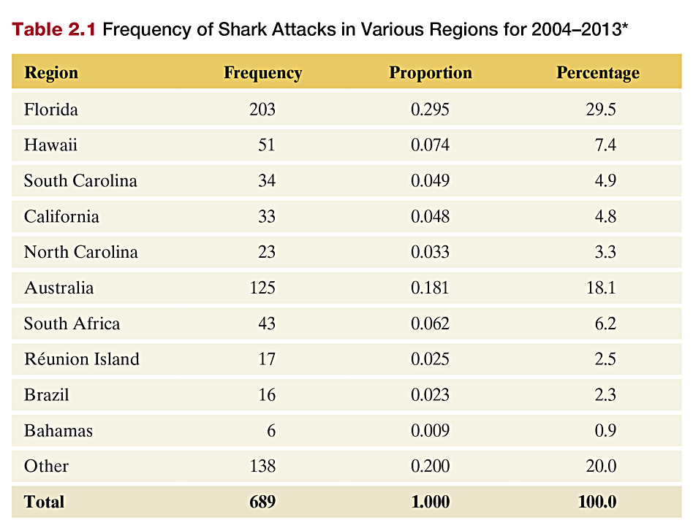
Frequency Table
A frequency table is a listing of possible values for a variable, together with the number of observations and/or relative frequencies for each value.
Table 2.1 Frequency of Shark Attacks in Various Regions for 2004–2013

Slide 27
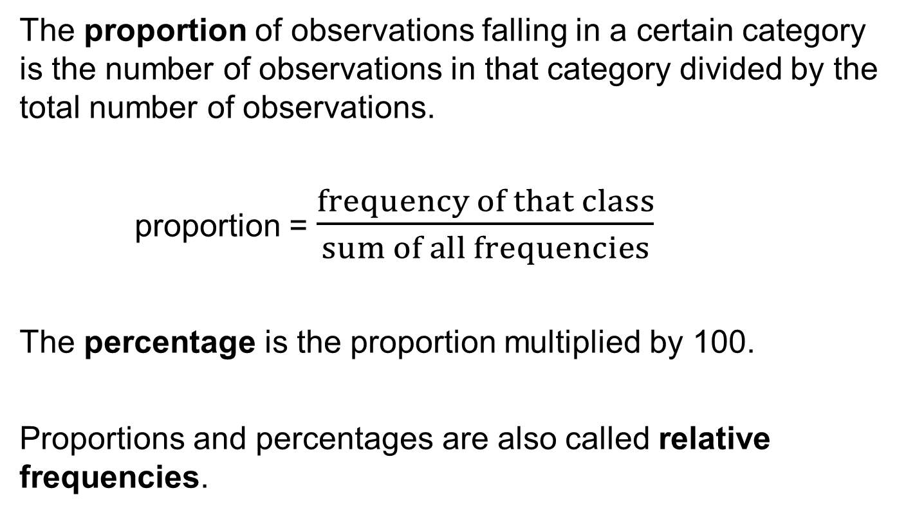
Proportion & Percentage (Relative Frequencies)
The proportion of observations falling in a certain category is the number of observations in that category divided by the total number of observations.
proportion = $\frac{frequency of that class}{sum of all frequencies}$
The percentage is the proportion multiplied by 100.
Proportions and percentages are also called relative frequencies.

Slide 28
Frequency, Proportion, & Percentage Example
There were 203 reported shark attacks in Florida between 2004 and 2013. Table 2.1 classifies 689 shark attacks reported from 2004 through 2013, so, for Florida,
  203 is the frequency.
  203/689 = 0.295 is the proportion and relative frequency.
  29.5 is the percentage 0.295 *100= 29.5%.

Slide 29
Discrete Quantitative Variable
To show the distribution for a discrete quantitative variable, we would similarly list the distinct values and the frequency of each one occurring.

Slide 30
Continuous Quantitative Variable
For a continuous quantitative variable (or when the number of possible outcomes is very large for a discrete variable), we divide the numeric scale on which the variable is measured into as set of nonoverlapping intervals and count the number of observations that fall in each interval. The frequency table then shows these intervals together with the corresponding count.

Slide 31
Graphical Summaries of Data

Slide 32
Graphs for Categorical Variables
The two primary graphical displays for summarizing a categorical variable are the pie chart and the bar graph.
Pie Chart: A circle having a “slice of pie” for each category
Bar Graph: A graph that displays a vertical bar for each category

Slide 33
Pie Charts
Pie Charts:
  Used for summarizing a categorical variable.
  Drawn as a circle where each category is represented as a “slice of the pie”.
  The size of each pie slice is proportional to the percentage of observations falling in that category.

Slide 34
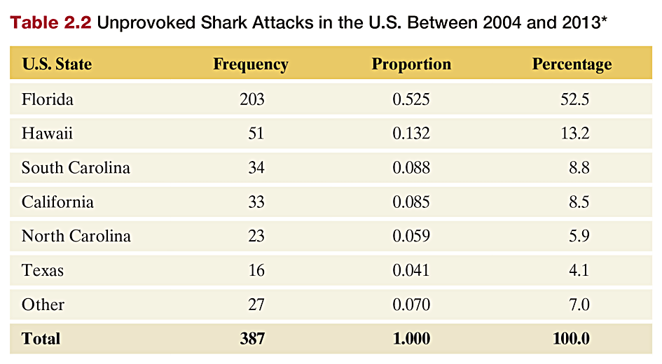
Example: Shark Attacks in the United States
Table 2.2 Unprovoked Shark Attacks in the U.S., 2004 - 2013

Slide 35
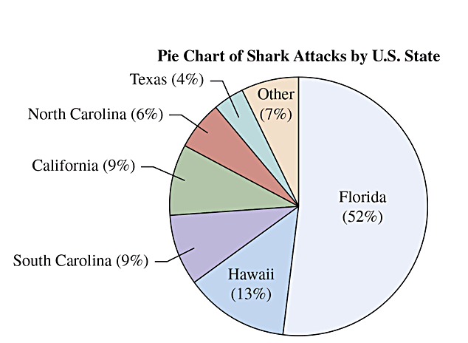
Example: Shark Attacks in the United States
Figure 2.1 Pie Chart of Shark Attacks Across U.S. States. The label for each
slice of the pie gives the category and the percentage of attacks in a state. The slice that
represents the percentage of attacks reported in Hawaii is 13% of the total area of the pie.
Question Why is it beneficial to label the pie wedges with the percent?

Slide 36
Bar Graphs
Bar graphs are used for summarizing a categorical variable.
Bar graphs display a vertical bar for each category.
The height of each bar represents either counts
(“frequencies”) or percentages (“relative frequencies”) for
that category.
It is usually easier to compare categories with a bar
graph rather than with a pie chart.
Bar graphs are called Pareto charts when the
categories are ordered by their frequency, from the
tallest bar to the shortest bar.

Slide 37
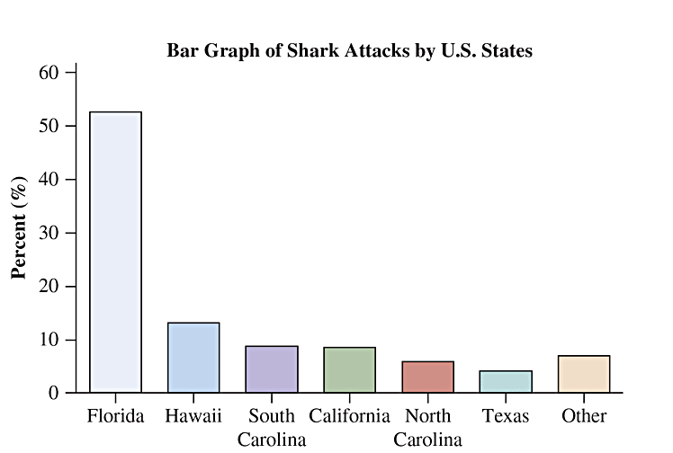
Example: Shark Attacks in the United States
Figure 2.2 Bar Graph of Shark Attacks Across U.S. States. Except for the Other
category, which is shown last, the bars are ordered from largest to smallest based on the frequency of shark attacks. Question What is the advantage of ordering the bars this way rather than alphabetically?

Slide 38
Graphs for Quantitative Variables
Dot Plot: shows a dot for each observation placed above its value on a number line.
Histogram: uses bars to portray the data.

Slide 39
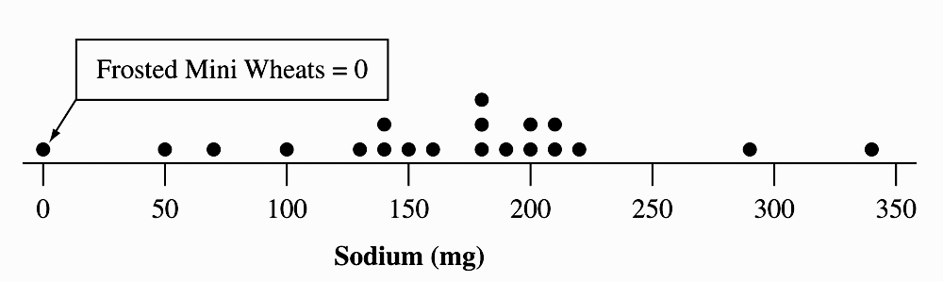
Dot Plots
Dot plots are used for summarizing a quantitative variable.
To construct a dot plot
Draw a horizontal line.
Label it with the name of the variable.
Mark regular values of the variable on it.
For each observation, place a dot above its value on the number line.

Slide 40
Steps for Constructing a Histogram
A histogram provides a versatile way to picture the distribution of a large data set.
Divide the range of the data into intervals of equal width.
Count the number of observations in each interval, creating a frequency table.
On the horizontal axis, label the values or the endpoints of the intervals.
Draw a bar over each value or interval with height equal to its frequency (or percentage), values of which are marked on the vertical axis.
Label and title appropriately.

Slide 41
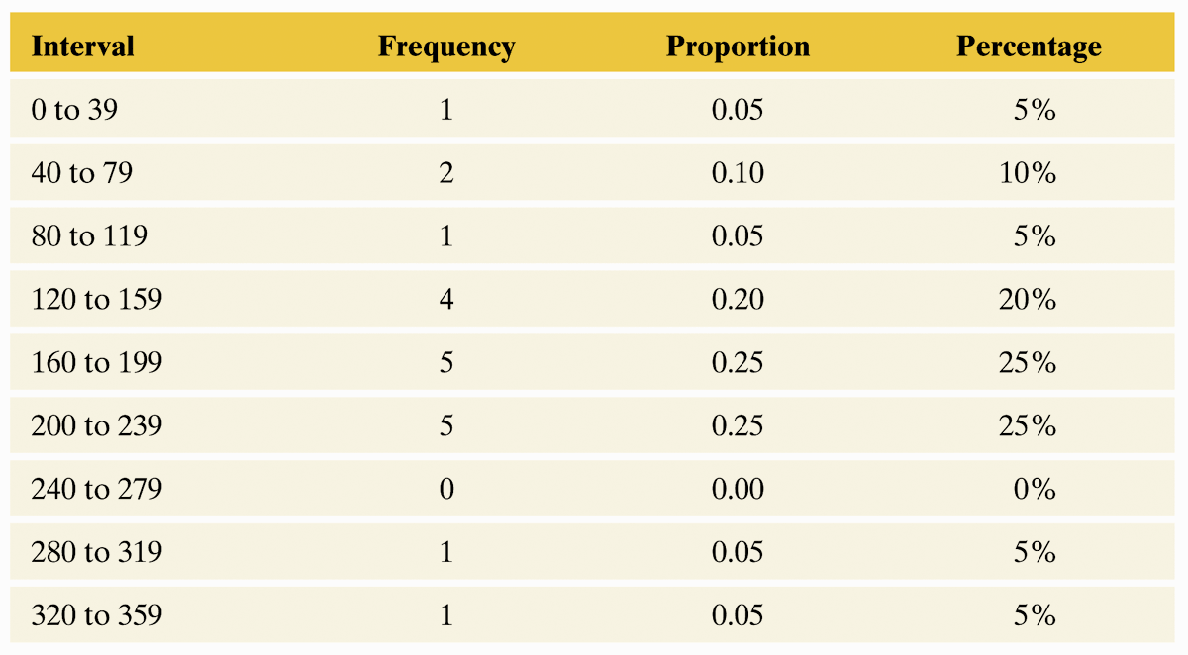
Example: Sodium in Cereals
Table 2.4 Frequency Table for Sodium in 20 Breakfast Cereals. The table summarizes the sodium values using eight intervals and lists the number of
observations in each, as well as the proportions and percentages.

Slide 42
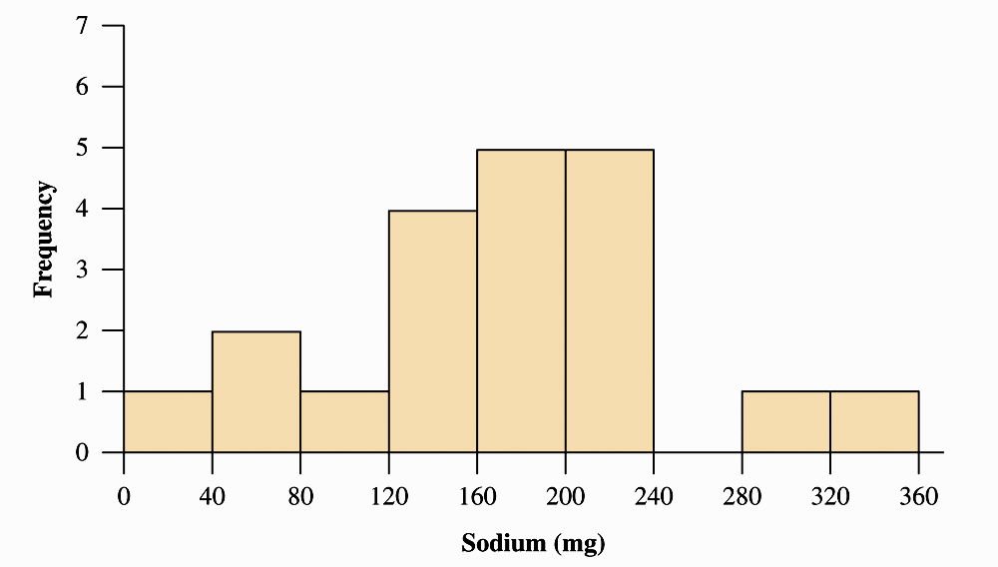
Histogram for Sodium in Cereals
Figure 2.6 Histogram of Breakfast Cereal Sodium Values. The rectangular bar over an interval has height equal to the number of observations in the interval.

Slide 43
Choosing a Graph Type
How do we decide which to use? Here are some guidelines:
Dot-plot
  More useful for small data sets
  Data values are retained
Histogram
  More useful for large data sets
  Most compact display
  More flexibility in defining intervals

Slide 44
Interpreting Histograms
Overall pattern consists of center, spread, and shape.
  Assess where a distribution is centered by finding the median (50% of data below median and 50% of data above).
  Assess the spread of a distribution.
  Shape of a distribution: roughly symmetric, skewed to the right, or skewed to the left

Slide 45
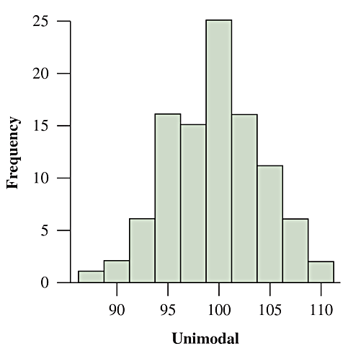
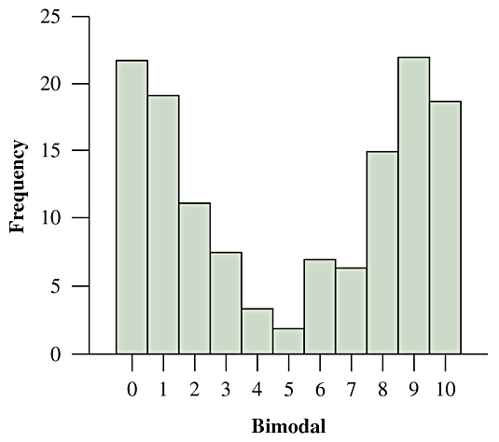
Shape
The value that occurs the most often is called the mode.
A distribution is unimodal if it has a single mound or peak.
A distribution is bimodal if it has two distinct mounds.

Slide 46
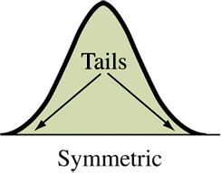
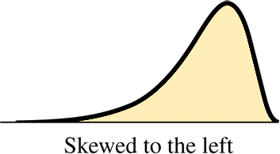
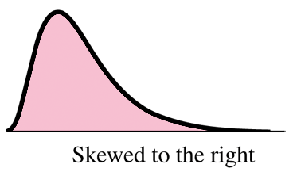
Shape
Symmetric Distributions: if both left and right sides of the histogram are mirror images of each other.
  A distribution is skewed
  to the left if the left tail is
  longer than the right tail.
  A distribution is skewed to
  the right if the right tail is
  longer than the left tail.

Slide 47
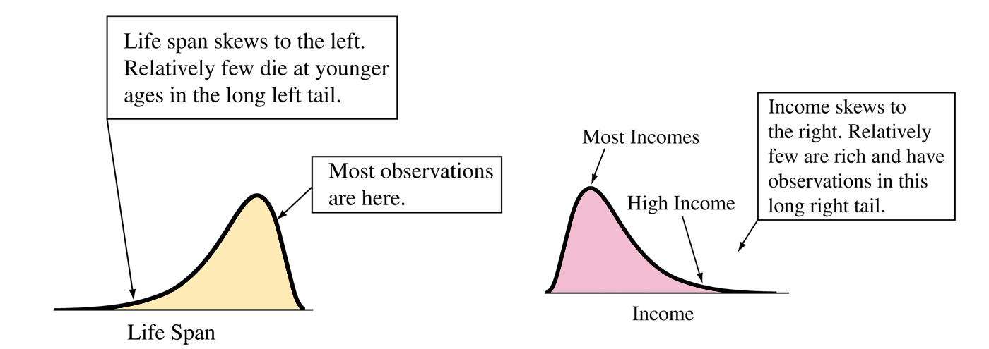
Examples of Skewness

Slide 48
Time Plots
A data set collected over time is called a time series.
Time plots are used to display time series data graphically.
Plots each observation on the vertical scale against the
time it was measured on the horizontal scale.
Common patterns in the data over time, known as
trends, should be noted.
To see a trend more clearly, it is beneficial to connect
the data points in their time sequence.

Slide 49
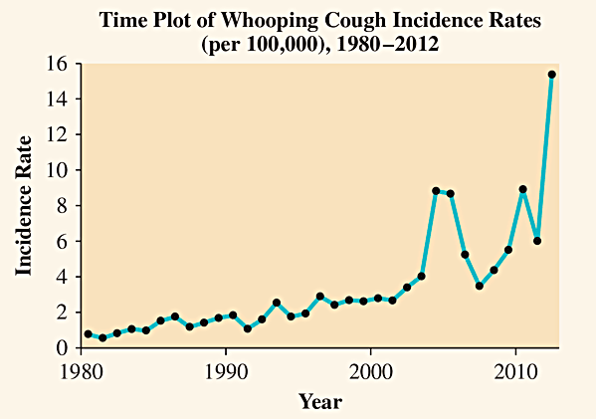
Time Plot Example
The figure shows a time plot of the incidence rate from1980 to 2012, based on numbers reported by the Center for Disease Control and Prevention.

Slide 50
The Association Between Two Categorical Variables

Slide 51
Response and Explanatory Variables
Response variable (Dependent variable)
  The outcome variable on which comparisons are made.
Explanatory variable (Independent variable)
  When the explanatory variable is categorical, it defines the groups to be compared with respect to the response variable.
  When the explanatory variable is quantitative, it defines the change in different numerical values to be compared with respect to the values for the response variable.
Example: Response/Explanatory
Carbon dioxide (CO₂) Level/Amount of gasoline use for cars
College GPA/Number of hours a week spent studying

Slide 52
Association Between Two Variables
The main purpose of data analysis with two variables is to investigate whether there is an association and to describe that association.
An association exists between two variables if particular values for one variable are more likely to occur with certain values of the other variable.

Slide 53
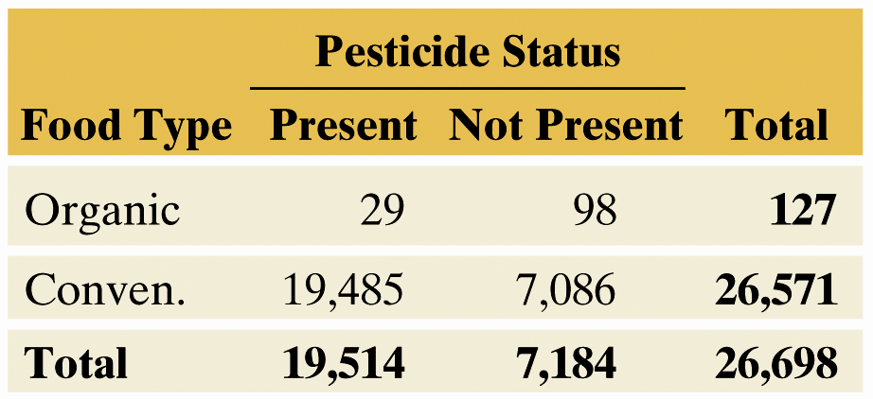
Contingency Tables
A Contingency Table:
  Displays two categorical variables.
  The rows list the categories of one variable.
  The columns list the categories of the other variable.
  Entries in the table are frequencies.
Table 3.1 Frequencies for Food Type and Pesticide Status. The row totals and the column totals are the frequencies for the categories of each variable. The counts inside the table give information about the association.

Slide 54
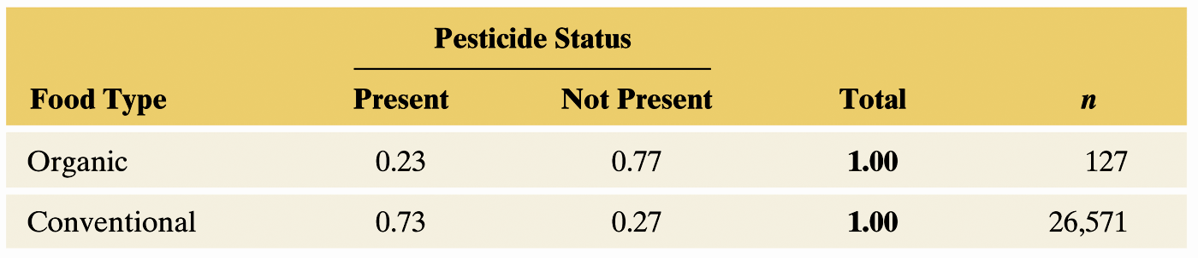
Calculate Proportions and Conditional Proportions
These proportions are called conditional proportions because their formation is conditional on (in this example) food type.
Table 3.2 Conditional Proportions on Pesticide Status, for Two Food Types. These conditional proportions (using two decimal places) treat pesticide status as the response variable. The sample size n in a row shows the total on which the conditional proportions in that row were based.
Notes:
54

Slide 55
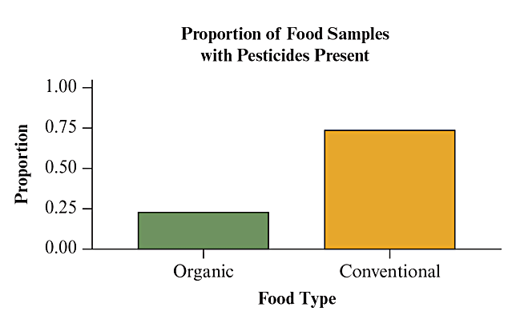
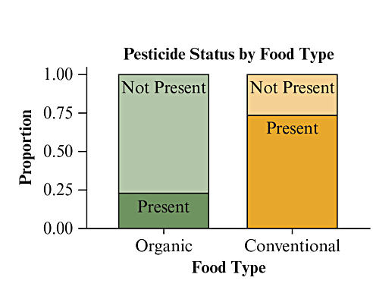
Calculate Proportions and Conditional Proportions
Using side by side bar charts or a stacked bar graph to show conditional proportions allows for easy comparison of the explanatory variable with respect to the response variable.
Figure 3.2 Conditional Proportions for Pesticide Status, Given the Food Type. The graph shows the proportion of food samples with pesticides present for both organically and conventionally grown food. It is called a side-by-side bar graph and allows an easy and direct comparison of the conditional proportions. Question Using the information displayed in the chart, how would you describe the difference between organic and conventionally grown foods with regard to pesticide status?
Notes:
55

Slide 56
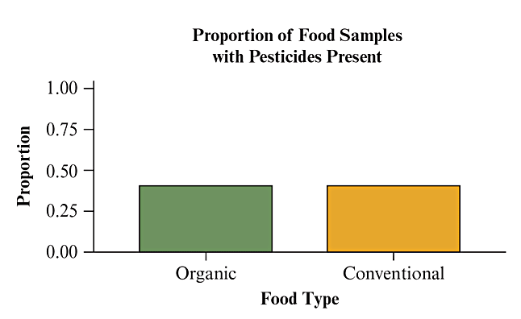
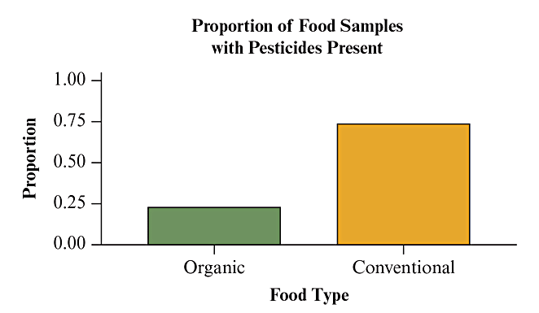
Looking For an Association
If there was no association between organic and conventional foods, then the proportions for the response variable categories would be the same for each food type.
Figure 3.2
Figure 3.3
Figure 3.3 Hypothetical Conditional Proportions on Pesticide Status, Given Food Type, Showing No Association. Question What’s the difference between Figures 3.2 and 3.3
in the pattern shown by the bars in the graph?

Slide 57
Association Between Two Quantitative Variables

Slide 58
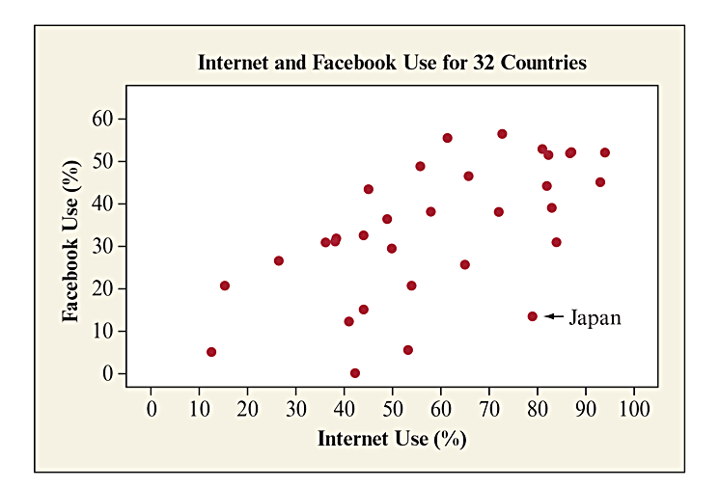
The Scatterplot: Looking for a Trend
Graphical display of relationship between two quantitative variables:
  Horizontal Axis: Explanatory variable, x
  Vertical Axis: Response variable, y
Figure 3.5 Scatterplot for Internet Use and Facebook Use. The point for Japan is labeled and has coordinates x = 79% and y = 13% . Question: Is there any point that you would identify as standing out in some way? Which country does it represent, and how is it unusual in the context of these variables?
Notes:
58

Slide 59
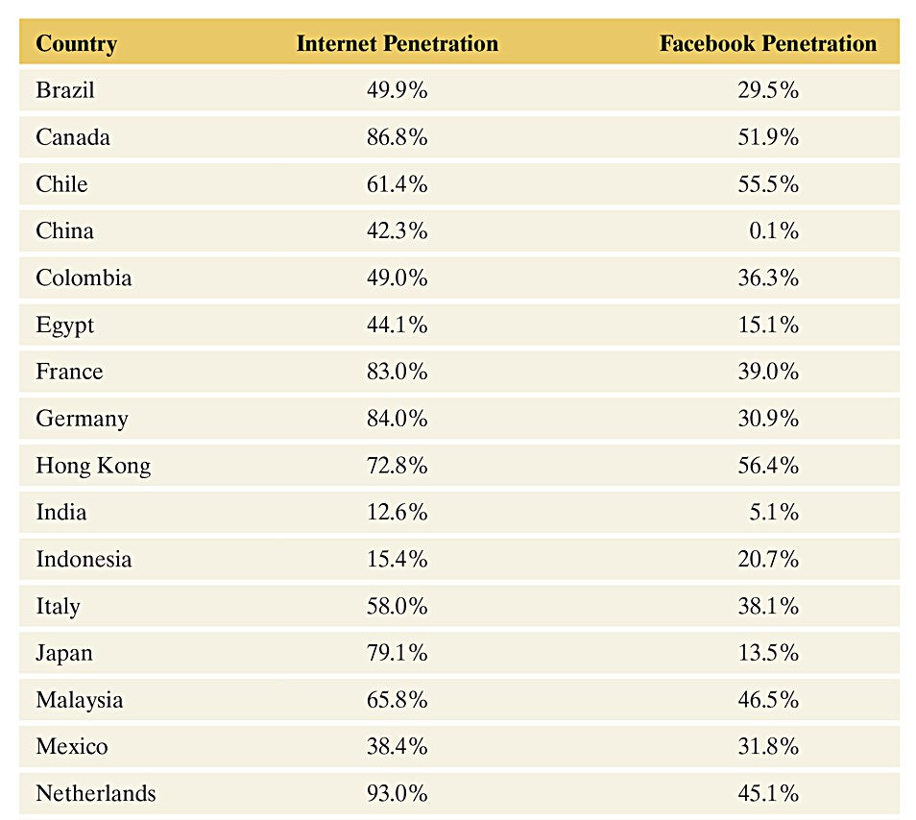
Example: Internet and Facebook Penetration Rates
Table 3.4 Internet and Facebook Penetration Rates For 31 Countries

Slide 60
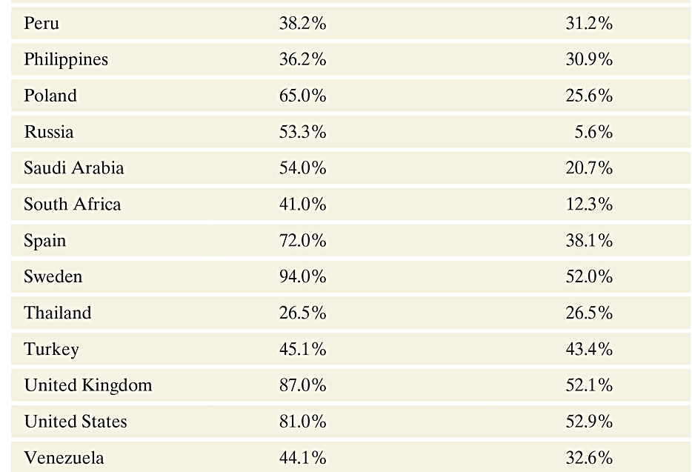
Example: Internet and Facebook Penetration Rates
Table 3.4 Internet and Facebook Penetration Rates For 32 Countries, cont’d.

Slide 61
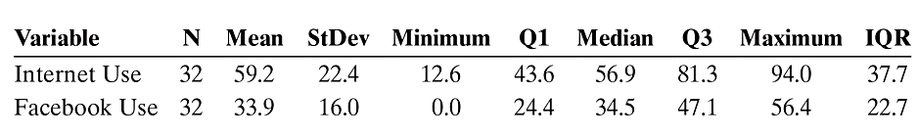
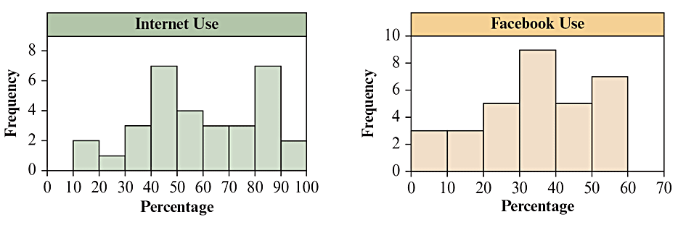
Example: Internet and Facebook Penetration Rates
Using many of the statistics from Chapter 2, we obtain the following numerical measures of center and spread:
Figure 3.4 Histograms of Internet use and Facebook use for the 32 countries. Question: Which nations, if any, might be outliers in terms of Internet use? Facebook use? Which graphical display would more clearly identify potential outliers?

Slide 62
How to Examine a Scatterplot
We examine a scatterplot to study association. How do values on the response variable change as values of the explanatory variable change?
You can describe the overall pattern of a scatterplot by the trend, direction, and strength of the relationship between the two variables.
  Trend: linear, curved, clusters, no pattern
  Direction: positive, negative, no direction
  Strength: how closely the points fit the trend
Also look for outliers from the overall trend.

Slide 63
Interpreting Scatterplots: Direction/Association
Two quantitative variables x and y are
  Positively associated when
    high values of x tend to occur with high values of y.
    low values of x tend to occur with low values of y.
  Negatively associated when high values of one variable tend to pair with low values of the other variable.

Slide 64
Summarizing the Strength of Association: The Correlation, r
The Correlation measures the strength and direction of the linear association between two quantitative variables.
  A positive r value indicates a positive association.
  A negative r value indicates a negative association.
  An r value close to +1 or -1 indicates a strong linear association.
  An r value close to 0 indicates a weak association.
Notes:
64

Slide 65
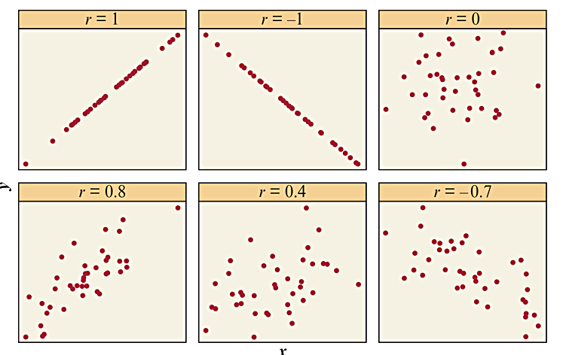
Correlation Coefficient: Measuring Strength and Direction of a Linear Relationship
Let’s get a feel for the correlation r by looking at its values for the scatterplots shown in Figure 3.7:
Figure 3.7 Some Scatterplots and Their Correlations. The correlation gets closer to when the data points fall closer to a straight line. Question: Why are the cases in which the data points are closer to a straight line considered to represent stronger association?

Slide 66
Properties of the Correlation
Always falls between -1 and +1.
Sign of correlation denotes direction.
  (-) indicates negative linear association.
  (+) indicates positive linear association.
Correlation has a unit-less measure, it does not depend
on the variables’ units.
Two variables have the same correlation no matter
which is treated as the response variable.
Correlation is not resistant to outliers.
Correlation only measures strength of a linear
relationship.

Slide 67
Predicting the Outcome of a Variable

Slide 68
Regression Line
The first step of a regression analysis is to identify the response and explanatory variables.
  We use y to denote the response variable.
  We use x to denote the explanatory variable.
Notes:
68

Slide 69
Regression Line: An Equation for Predicting the Response Outcome
The regression line predicts the value for the response variable y as a straight-line function of the value x of the explanatory variable.
Let denote the predicted value of y. The equation for the regression line has the form
In this formula, a denotes the y-intercept and b denotes the slope.
Notes:
69

Slide 70
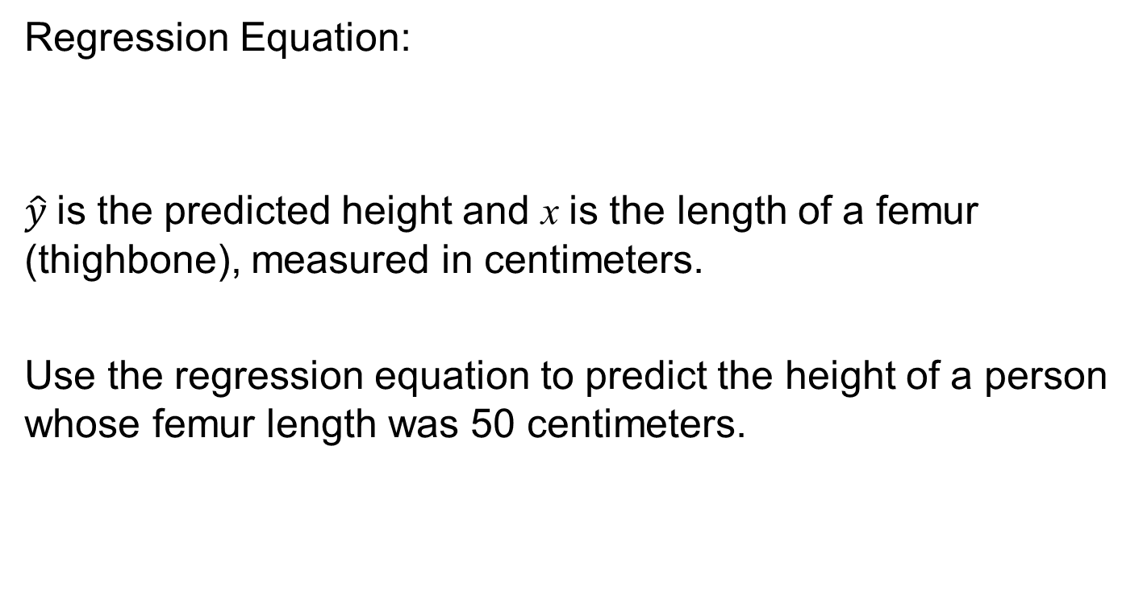
Example: Height Based on Human Remains
Notes:
70

Slide 71
Interpreting the y-Intercept
y-Intercept:
  The predicted value for y when
  This fact helps in plotting the line.
  May not have any interpretative value if no observations had x values near 0.
  It does not make sense for femur length to be 0 cm, so
  the y-intercept for the equation is not
  a relevant predicted height.
Notes:
71

Slide 72
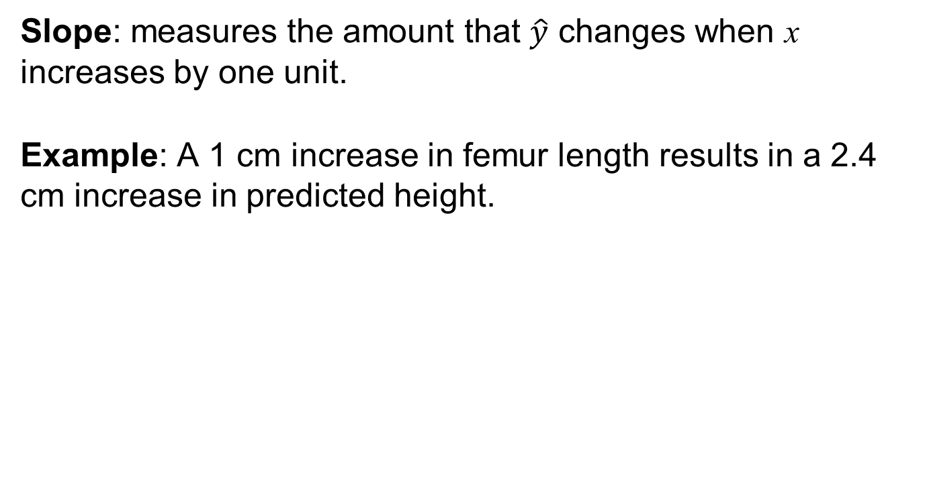
Interpreting the Slope
Notes:
72

Slide 73
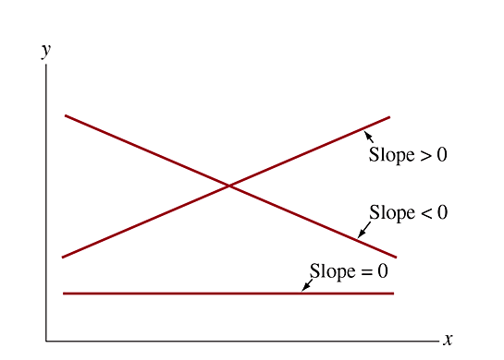
Slope Values: Positive, Negative, Equal to 0
Figure 3.12 Three Regression Lines Showing Positive Association (slope > 0), Negative Association (slope < 0) and No Association (slope = 0). Question Would you expect a positive or negative slope when y = annual income and x = number of years of education?
Notes:
73

Slide 74
Residuals Measure the Size of Prediction Errors
Residuals measure the size of the prediction errors, the vertical distance between the point and the regression line.
  Each observation has a residual.
  Calculation for each residual:
A large residual indicates an unusual observation.
The smaller the absolute value of a residual, the closer
the predicted value is to the actual value, so the better is
the prediction.
Notes:
74

Slide 75
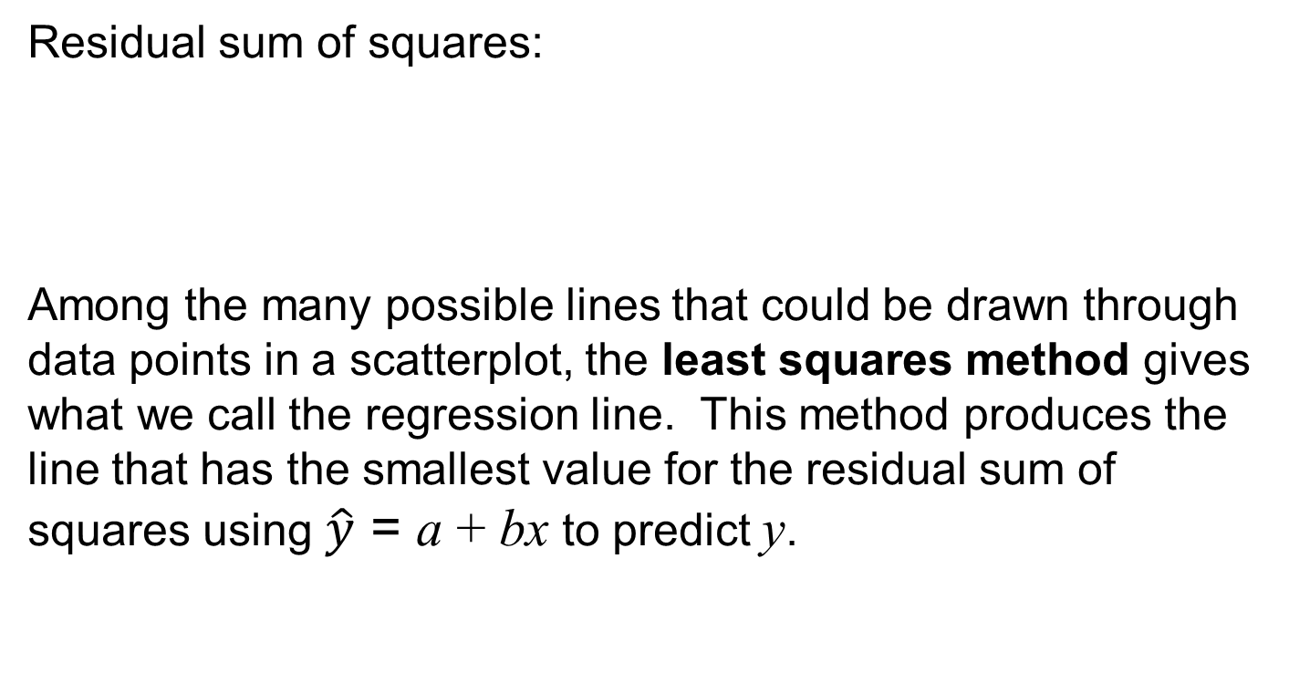
The Method of Least Squares Yields the
Regression Line
Notes:
75

Slide 76
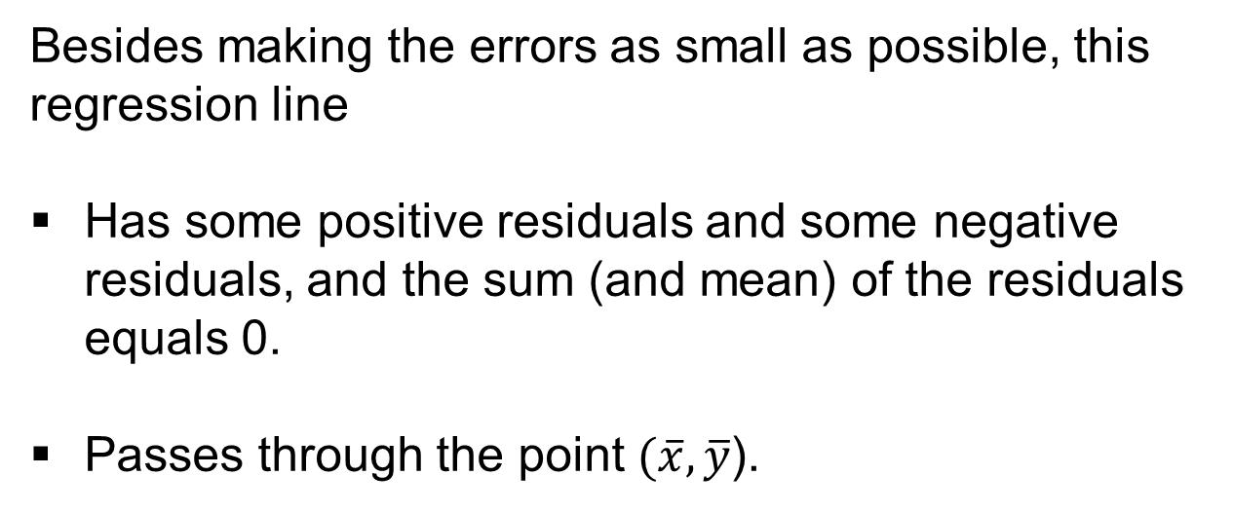
The Method of Least Squares Yields the
Regression Line
Notes:
76

Slide 77
Regression Formulas for y-Intercept and Slope
Slope:
y-Intercept:
Notice that the slope b is directly related to the correlation r, and the y-intercept depends on the slope.
Notes:
77

Slide 78
The Slope and the Correlation
Correlation:
  Describes the strength of the linear association between 2 variables.
  Does not change when the units of measurement change.
  Does not depend upon which variable is the response and which is the explanatory.
Notes:
78

Slide 79
The Slope and the Correlation
Slope:
  Numerical value depends on the units used to measure the variables.
  Does not tell us whether the association is strong or weak.
  The two variables must be identified as response and explanatory variables.
  The regression equation can be used to predict values of the response variable for given values of the explanatory variable.
Notes:
79

Slide 80
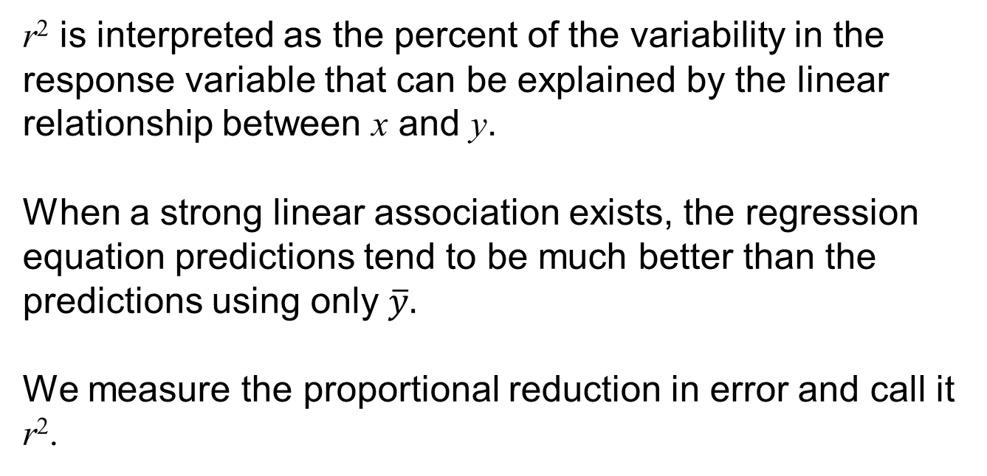
The Squared Correlation
Notes:
80

Slide 81
The Squared Correlation
r² measures the proportion of the variation in the y values that is accounted for by the linear relationship of y with x.
In Ex 7, we found r = 0.614.
  This means that 37.7% of the variability we observe in Facebook use (the response variable) is due to the linear relationship between Internet and Facebook use.

Slide 82
Cautions in Analyzing Associations

Slide 83
Extrapolation Is Dangerous
Extrapolation: Using a regression line to predict y values for x values outside the observed range of the data
  Riskier the farther we move from the range of the given x values.
  There is no guarantee that the relationship given by the regression equation holds outside the range of sampled x values.
Notes:
83

Slide 84
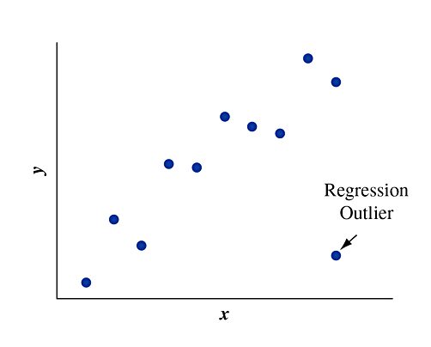
Be Cautious of Influential Outliers
One reason to plot the data before you do a correlation or regression analysis is to check for unusual observations.
Search for observations that are
regression outliers, being well
removed from the trend that the
rest of the data follow.
Notes:
84

Slide 85
Outliers and Influential Points
A regression outlier is an observation that lies far away from the trend that the rest of the data follows.
An observation is influential if
  its x value is relatively low or high compared to the remainder of the data.
  the observation is a regression outlier.
Influential observations tend to pull the regression line
toward that data point and away from the rest of the
data points.

Slide 86
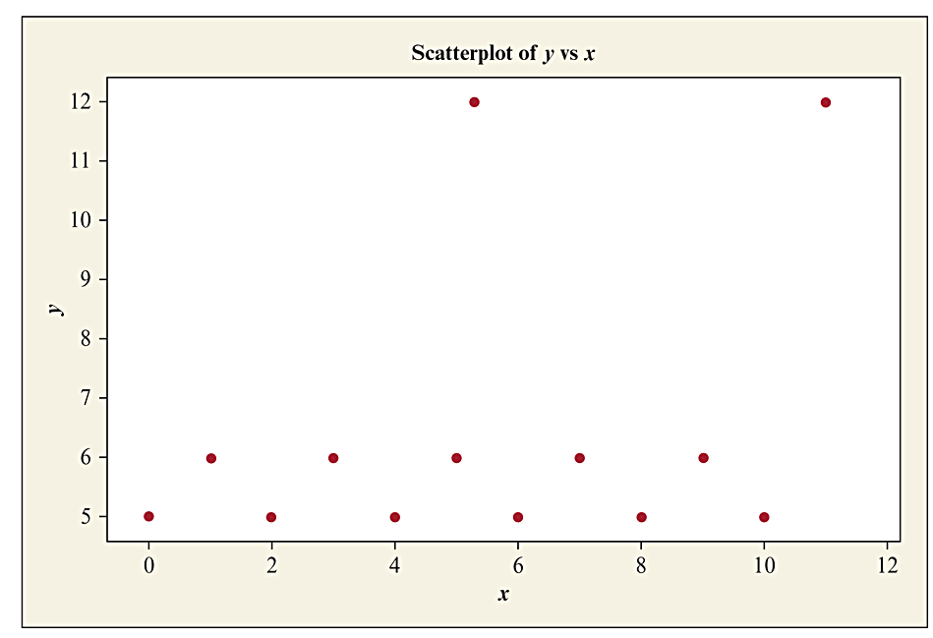
Outliers and Influential Points
Figure 3.18 An Observation Is a Regression Outlier if it is Far Removed from the Trend that the Rest of the Data Follow. The top two points are regression outliers. Not all regression outliers are influential in affecting the correlation or slope. Question: Which regression outlier in this figure is influential?

Slide 87
Correlation Does Not Imply Causation
Suppose that as x goes up, y also tends to go up (or down). Can we conclude that there’s a causal connection, with changes in x causing changes in y?
  A strong correlation between x and y means that there is a strong linear association that exists between the two variables.
  A strong correlation between x and y, does not mean that x causes y to change.
  Spurious Correlation
Notes:
87

Slide 88
Lurking Variables
A lurking variable is a variable, usually unobserved, that influences the association between the variables of primary interest.
  Ice cream sales and drowning – lurking variable = temperature
  Reading level and shoe size – lurking variable = age
  Childhood obesity rate and GDP-lurking variable = time
Notes:
88

Slide 89
Simpson’s Paradox
Simpson’s Paradox:
When the direction of an association between two variables changes after we include a third variable and analyze the data at separate levels of that third variable.
Notes:
89

Slide 90
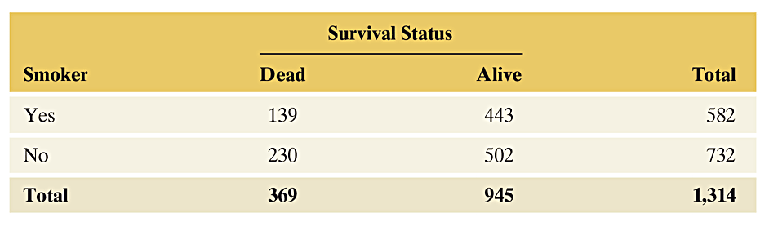
Simpson’s Paradox Example: Smoking and Health
Is Smoking Actually Beneficial to Your Health?
Table 3.7 Smoking Status and 20-Year Survival in Women
Probability of Death of Smoker = 139/582= 24%
Probability of Death of Nonsmoker = 230/732= 31%
This can’t be true that smoking improves your chances of living!
What’s going on?!
Notes:
90

Slide 91
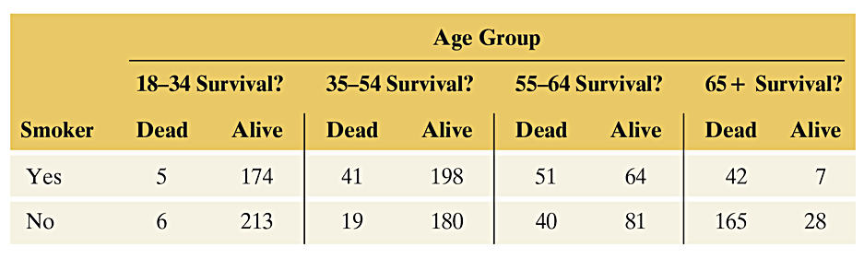
Simpson’s Paradox Example: Smoking and Health
Break out Data by Age
Table 3.8 Smoking Status and 20-Year Survival, for Four Age Groups
Notes:
91

Slide 92
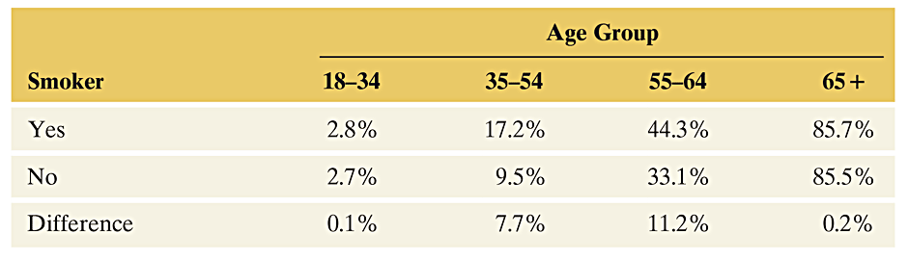
Simpson’s Paradox Example: Smoking and Health
For instance, for smokers of age 18–34, from Table 3.8 the proportion who died was 5/(5 + 174) = 0.028, or 2.8%.
Could age explain the association?
Table 3.9 Conditional Percentages of Deaths for Smokers and Nonsmokers, by Age
Notes:
92

Slide 93
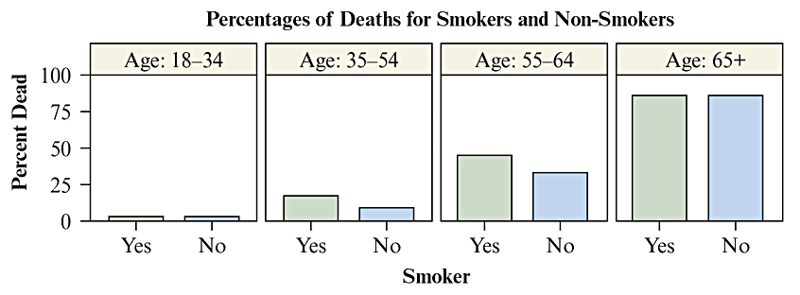
Simpson’s Paradox Example: Smoking and Health
Figure 3.23 Bar Graph Comparing Percentage of Deaths for Smokers and Nonsmokers, by Age. This side-by-side bar graph shows the conditional percentages
from Table 3.9.
An association can look quite different after adjusting for the effect of a third variable by grouping the data according to the values of the third variable (age).
Notes:
93

Slide 94
The Effect of Lurking Variables on Associations
Lurking variables can affect associations in many ways. For instance, a lurking variable may be a common cause of both the explanatory and response variable.
In practice, there’s usually not a single variable that causally explains a response variable or the association between two variables. More commonly, there are multiple causes. When there are multiple causes, the association among them makes it difficult to study the effect of any single variable.
Notes:
94

Slide 95
Lurking Variables & Confounding
When two explanatory variables are both associated with a response variable but are also associated with each other, there is said to be confounding.
Lurking variables are not measured in the study but have the potential for confounding.
Notes:
95

Slide 96
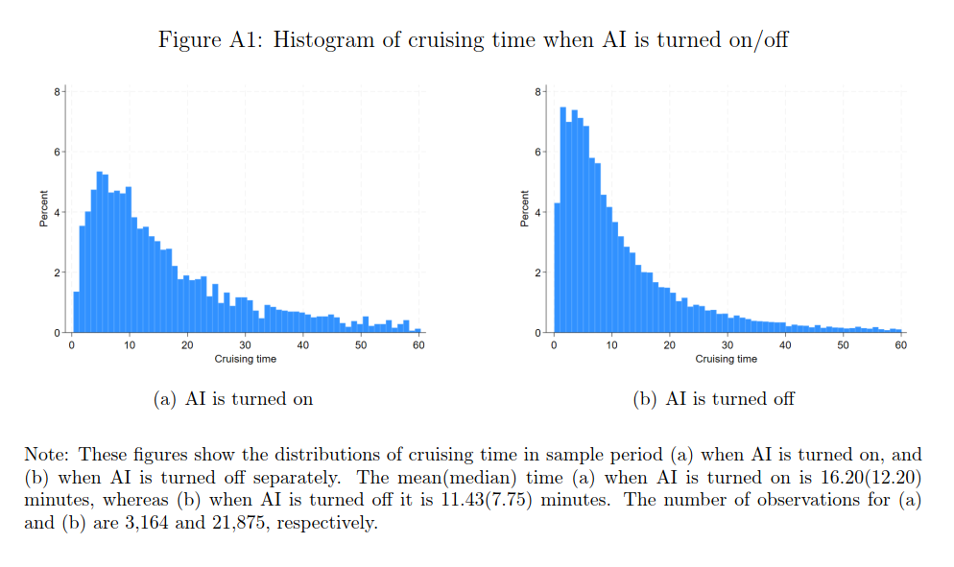
Other Example
Source: Kanazawa, Kyogo, et al. "AI, skill, and productivity: The case of taxi drivers." Management Science (2025).
Notes:
96

Slide 97
Experimental and Observational Studies

Slide 98
Type of Study: Experiment
A researcher conducts an experimental study, or more simply, an experiment, by assigning subjects to certain experimental conditions and then observing outcomes on the response variable (or variables).
The experimental conditions, which correspond to assigned values of the explanatory variable, are called treatments.
Notes:
98

Slide 99
Type of Study: Observational Study
In an observational study, the researcher observes values of the response variable and explanatory variables for the sampled subjects, without anything being done to the subjects (such as imposing a treatment).
In short, an observational study merely observes rather than experiments with the study subjects. An experimental study assigns to each subject one or more treatments and then observes the outcome on the response variable.
Notes:
99

Slide 100
Example: Drug Testing and Student Drug Use
A headline read: “Student Drug Testing Not Effective in Reducing Drug Use” in a news release from the University of Michigan.
Facts about the study:
  76,000 students nationwide
  497 high schools and 225 middle schools
  Schools selected for the study included schools that tested for drugs and schools that did not test for drugs.
  Each student filled out a questionnaire asking about his/her drug use.
Notes:
100

Slide 101
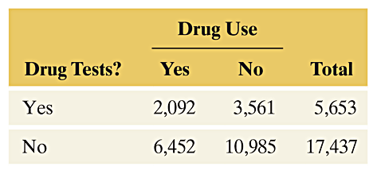
Example: Drug Testing and Student Drug Use
Results From Questionnaire on Drug Use
Questions:
What were the response and explanatory variables?
Was this an observational study or an experiment?
Notes:
101

Slide 102
Example: Drug Testing and Student Drug Use
This study was an observational study.
In order for it to be an experiment, the researcher would had to have assigned each school to use or not use drug testing rather than leaving this decision to the school.
Notes:
102

Slide 103
Advantage of Experiments Over Observational Studies
In an observational study, lurking variables can affect the results. By contrast, an experiment reduces the potential for lurking variables to affect the results.
It’s not possible to establish cause and effect definitively with observational studies. Association does not imply causation.
We can study the effect of an explanatory variable on a response variable more accurately with an experiment than with an observational study.

Slide 104
Determining Which Type of Study is Possible
If experiments are preferable, why ever conduct an observational study? There are obvious difficulties with conducting some experiments:
It’s not ethical for a study to expose over a long period of time some of the subjects to something (such as cell phone radiation) that we suspect may be harmful.
It’s difficult in practice to make sure that the subjects behave as told. How can you monitor them to ensure that they adhere to their treatment assignment over the 50-year experimental period?
Who wants to wait 50 years to get an answer?

Slide 105
Using Data Already Available
Informal observations are called anecdotal evidence. Unfortunately, there is no way to tell whether they are representative of what happens for an entire population.
A famous saying is, “The plural of anecdote is not data.” Instead of using anecdotal evidence to draw conclusions, you should rely on data from reputable studies.

Slide 106
The Census and Other Sample Surveys
A sample survey selects a sample of people from a population and collects data from them.
A sample survey is a type of nonexperimental study.
A census attempts to count the number of people in the population and to measure certain characteristics about them.

Slide 107
The Census
Other than counting the population size, here are three key reasons for conducting the U.S. census:
The Constitution mandates that seats in the House of Representatives be apportioned to states based on their portion of the population measured by the census.
Census data are used in the drawing of boundaries for electoral districts.
Census data are used to determine the distribution of federal dollars to states and local communities.

Slide 108
Good and Poor Ways to Sample

Slide 109
Sampling Frame and Sampling Design
The sampling frame is the list of subjects in the population from which the sample is taken.
Ideally, the sampling frame lists the entire population of interest. In practice, it is usually hard to identify every subject in the population.
Once you have a sampling frame, you need to specify a method for selecting subjects from it. The method used is called the sampling design.

Slide 110
Simple Random Sampling
A simple random sample of n subjects from a population is one in which each possible sample of that size has the same chance of being selected.
A simple random sample is often just called a random sample. The “simple” adjective distinguishes this type of sampling from more complex random sampling designs presented in Section 4.4.
Notes:
110

Slide 111
Selecting a Simple Random Sample
To select a simple random sample:
  Number the subjects in the sampling frame.
  Generate a set of those numbers randomly.
  Sample the subjects whose numbers were generated.
  In practice, technology is used to generate the sample. This could be an app or a statistical program.

Slide 112
Methods of Collecting Data in Sample Surveys
For any survey, it is difficult to get a good sampling frame since a list of all adults in a population typically does not exist. So, it’s necessary to pick a place where almost all people can be found—a person’s place of residence.
Once we identify the desired sample for a survey, how do we contact the people to collect the data?
  Personal interview
  Telephone interview
  Self-administered questionnaire

Slide 113
Sources of Potential Bias in Sample Surveys
Bias: When results from the sample are not representative of the population, they are said to exhibit bias.
Undercoverage – having a sampling frame that lacks representation from parts of the population.
Notes:
113

Slide 114
SUMMARY: Types of Bias in Sample Surveys
Sampling bias occurs from using nonrandom samples or having undercoverage.
Nonresponse bias occurs when some sampled subjects cannot be reached or refuse to participate or fail to answer some questions.
Response bias occurs when the subject gives an incorrect response (perhaps lying) or the way the interviewer asks the questions (or wording of a question in print) is confusing or misleading.
Notes:
114

Slide 115
Poor Ways to Sample
How the sample is obtained can also result in bias.
Convenience Samples: a type of survey sample that is easy to obtain relatively cheaply.
  Unlikely to be representative of the population
  Often severe biases result from such a sample.
  Results apply ONLY to the observed subjects.
Notes:
115

Slide 116
Poor Ways to Sample
Volunteer Sample: most common type of convenience sample
  Subjects volunteer for the sample.
  Volunteers do not tend to be representative of the entire population.
Notes:
116

Slide 117
A Large Sample Size Does Not Guarantee an Unbiased Sample
Many Internet surveys have thousands of respondents, but a volunteer sample of thousands is not as good as a random sample, even if that random sample is much smaller.
We’re almost always better off with a simple random sample of 100 people than with a volunteer sample of thousands of people.
Notes:
117

Slide 118
SUMMARY: Key Parts of a Sample Survey
Identify the population of all subjects of interest.
Construct a sampling frame which attempts to list all subjects in the population.
Use a random sampling design to select n subjects from the sampling frame.
Be cautious about sampling bias due to nonrandom samples (such as volunteer samples) and sample undercoverage, response bias from subjects not giving their true response or from poorly worded questions, and nonresponse bias from refusal of subjects to participate.
We can make inferences about the population of interest when
sample surveys that use random sampling are employed.

Slide 119
Good and Poor Ways to Experiment

Slide 120
Definitions
Experimental units: The subjects of an experiment; the entities that we measure in an experiment.
Treatment: A specific experimental condition imposed on the subjects of the study; the treatments correspond to assigned values of the explanatory variable.
Explanatory variable: Defines the groups to be compared with respect to values on the response variable.
Response variable: The outcome measured on the subjects to reveal the effect of the treatment(s).

Slide 121
Experiments
An experiment deliberately imposes treatments on the
experimental units in order to observe their responses.
The goal of an experiment is to investigate the association – how the treatment affects the response.
An advantage of an experimental study over a nonexperimental study is that it provides stronger evidence for causation.

Slide 122
The Elements of a Good Experiment
Control Comparison Group: allows the researcher to analyze the effectiveness of the primary treatment.
Randomization: eliminates possible researcher bias, balances the comparison groups on known as well as on lurking variables.
Blinding the Study: allows the researcher to treat the treatment groups as equally as possible.
Notes:
122

Slide 123
Control Comparison Group
A placebo is a dummy treatment, i.e. sugar pill. Many
subjects respond favorably to any treatment, even a
placebo.
A control group typically receives a placebo. A control group allows us to analyze the effectiveness of the primary treatment.

Slide 124
Placebo Effect
Placebo effect: people who take a placebo tend to respond better than those who receive nothing, perhaps for psychological reasons.
In some experiments, a control group may receive an existing treatment rather than a placebo.

Slide 125
Randomization
Use randomization for assigning subjects to the treatments
To eliminate bias that may result if you (the researchers) assign the subjects.
To balance the groups on variables that you know affect the response.
To balance the groups on lurking variables that may be unknown to you.
Notes:
125

Slide 126
Blinding the Study
It is important that the treatment groups be treated as equally as possible.
Ideally, the subjects are blind to the treatment to which they are assigned.
When neither the subject nor those having contact with the subject know the treatment assignment, the study is called double-blind. This is ideal.

Slide 127
Generalizing Results to Broader Populations
Recall that the goal of experimentation is to analyze the association between the treatment and the response for the population, not just the sample.
However, care should be taken to generalize the results of a study only to the population that is represented by the study.

Slide 128
SUMMARY: Key Parts of a Good Experiment
A good experiment has a control comparison group, randomization in assigning experimental units to treatments, and blinding.
The experimental units are the subjects—the people, animals, or other objects to which the treatments are applied.
The treatments are the experimental conditions imposed on the experimental units. One of these may be a control (for instance, either a placebo or an existing treatment) that provides a basis for determining whether a particular treatment is effective. The treatments correspond to values of an explanatory variable.

Slide 129
SUMMARY: Key Parts of a Good Experiment
Randomly assign the experimental units to the treatments. This tends to balance the comparison groups with respect to lurking variables.
Replication of studies increases confidence in the conclusions.

